Slide 1

Artificial intelligence to enhance BIM-BEPS integration via IFC: Challenges, solutions, and future directions
Week of February 23
Jacob Appling

Slide 2
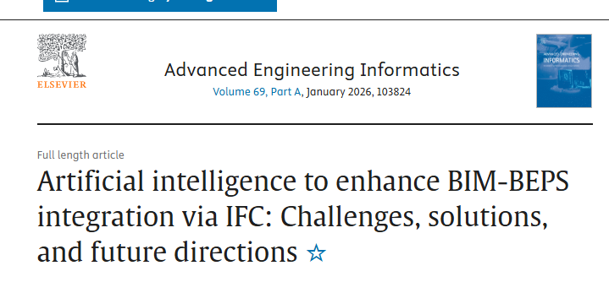
Article #4 (Row 4 via Google Sheet)

Slide 3
Link to the Source
https://www.sciencedirect.com/science/article/abs/pii/S1474034625007177

Slide 4
Main Findings
Core argument: The paper argues that AI can meaningfully improve interoperability between BIM and Building Energy Performance Simulation (BEPS) when the exchange is done through IFC (Industry Foundation Classes), which is widely used but still error-prone and inefficient in practice.
What the authors do: It’s essentially a structured literature review / mapping study that:
identifies where BIM→BEPS workflows break down when exporting/importing IFC,
groups these issues into categories (modeling/export quality vs. IFC schema/structure issues),
and maps AI-enabled solution approaches to those problem types.
Key solution areas highlighted: The paper points to AI (and AI-adjacent methods) helping most in:
automating geometry extraction from IFC for simulation-ready models,
geometric and data “enrichment” (filling gaps, adding missing simulation-relevant properties),
inconsistency/error detection (finding conflicts, malformed spaces/zones, missing or misinterpreted attributes),
and rule-checking frameworks (notably ontologies + rules) combined with ML for classification/verification tasks.
Adoption reality check: The authors emphasize that AI won’t “magically fix” bad workflows—quality inputs, clear modeling requirements, and standardized processes are still essential to get value.

Slide 5
Broader implications for society
Better energy outcomes at scale: If BIM→BEPS integration becomes more reliable and automated, energy simulation can be used earlier and more often, supporting design decisions that reduce energy use and carbon impacts over a building’s lifecycle.
Shifting expertise and workforce needs: Wider AI adoption increases demand for professionals who can manage data quality, standards, and model governance, not just “run the software.” That implies changes in training, roles, and expectations across AEC.
Trust and accountability: Using AI to infer missing properties or “fix” models raises societal questions about transparency and validation—who is responsible if an AI-enriched model produces misleading simulation results? (The paper frames this through barriers to adoption and workflow discipline.)

Slide 6
Relevance and potential influence on the construction industry
Practical impact on BIM/VDC + sustainability workflows: The work targets a real pain point: BIM models often aren’t simulation-ready, and IFC transfers can be messy. AI-assisted extraction, enrichment, and checking could reduce manual remodeling, speed up iteration cycles, and improve design-to-performance decision-making.
Standardization becomes even more valuable: The authors stress that the industry needs well-defined modeling requirements, level-of-detail expectations, and process maps for different analysis types—otherwise AI tools will be limited by inconsistent inputs.
Signals where tools may evolve next: The paper highlights opportunities around IFC4 and future IFC generations, and especially hybrid approaches (ontology/rules + ML) as a likely direction for more robust, scalable BIM→BEPS interoperability tooling.

